Slide 1
Content
Introduction
Problem definition of the Application(Brief Description of Application)
System description
Hardware & software requirements
User Interface Design (GUI snapshots)
Applications of the System
Conclusions
Future Scope
Literature Cited (book and web References)
Acknowledgements
1
Project Title
Notes:
1

Slide 2
Introduction
Our project is a to create a hotel management system which will make booking a hotel a seamless and hassle-free experience.
It also provides a smooth experience to the admin who is able to view all the information in regards to rooms, reservations and users currently using the system.
With the increasing trend of “all things online” our system enables that and also reduces person to person contact through a digital method.
2
Hotel Management System
Notes:
2

Slide 3
Problem definition
The purpose of this project is to make a hotel management system to make it easier to manage rooms in a hotel.
Rooms can be booked based on their category and the capacity of people. When booking the system checks the check-in and the check-out dates to see if there the room is booked
Users can book a hotel easily and with a seamless experience.
An admin user can also manage the details of rooms, view bookings, view users, add rooms and delete rooms.
3
Hotel Management System
Notes:
3

Slide 4
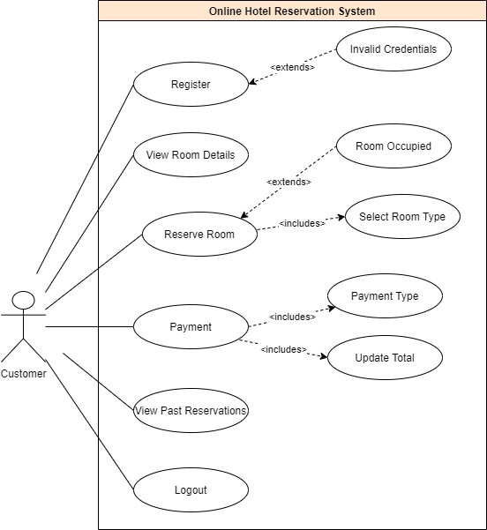
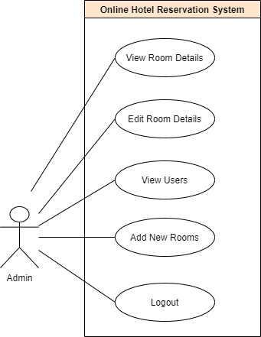
System description
4
Hotel Management System
Notes:
4

Slide 5
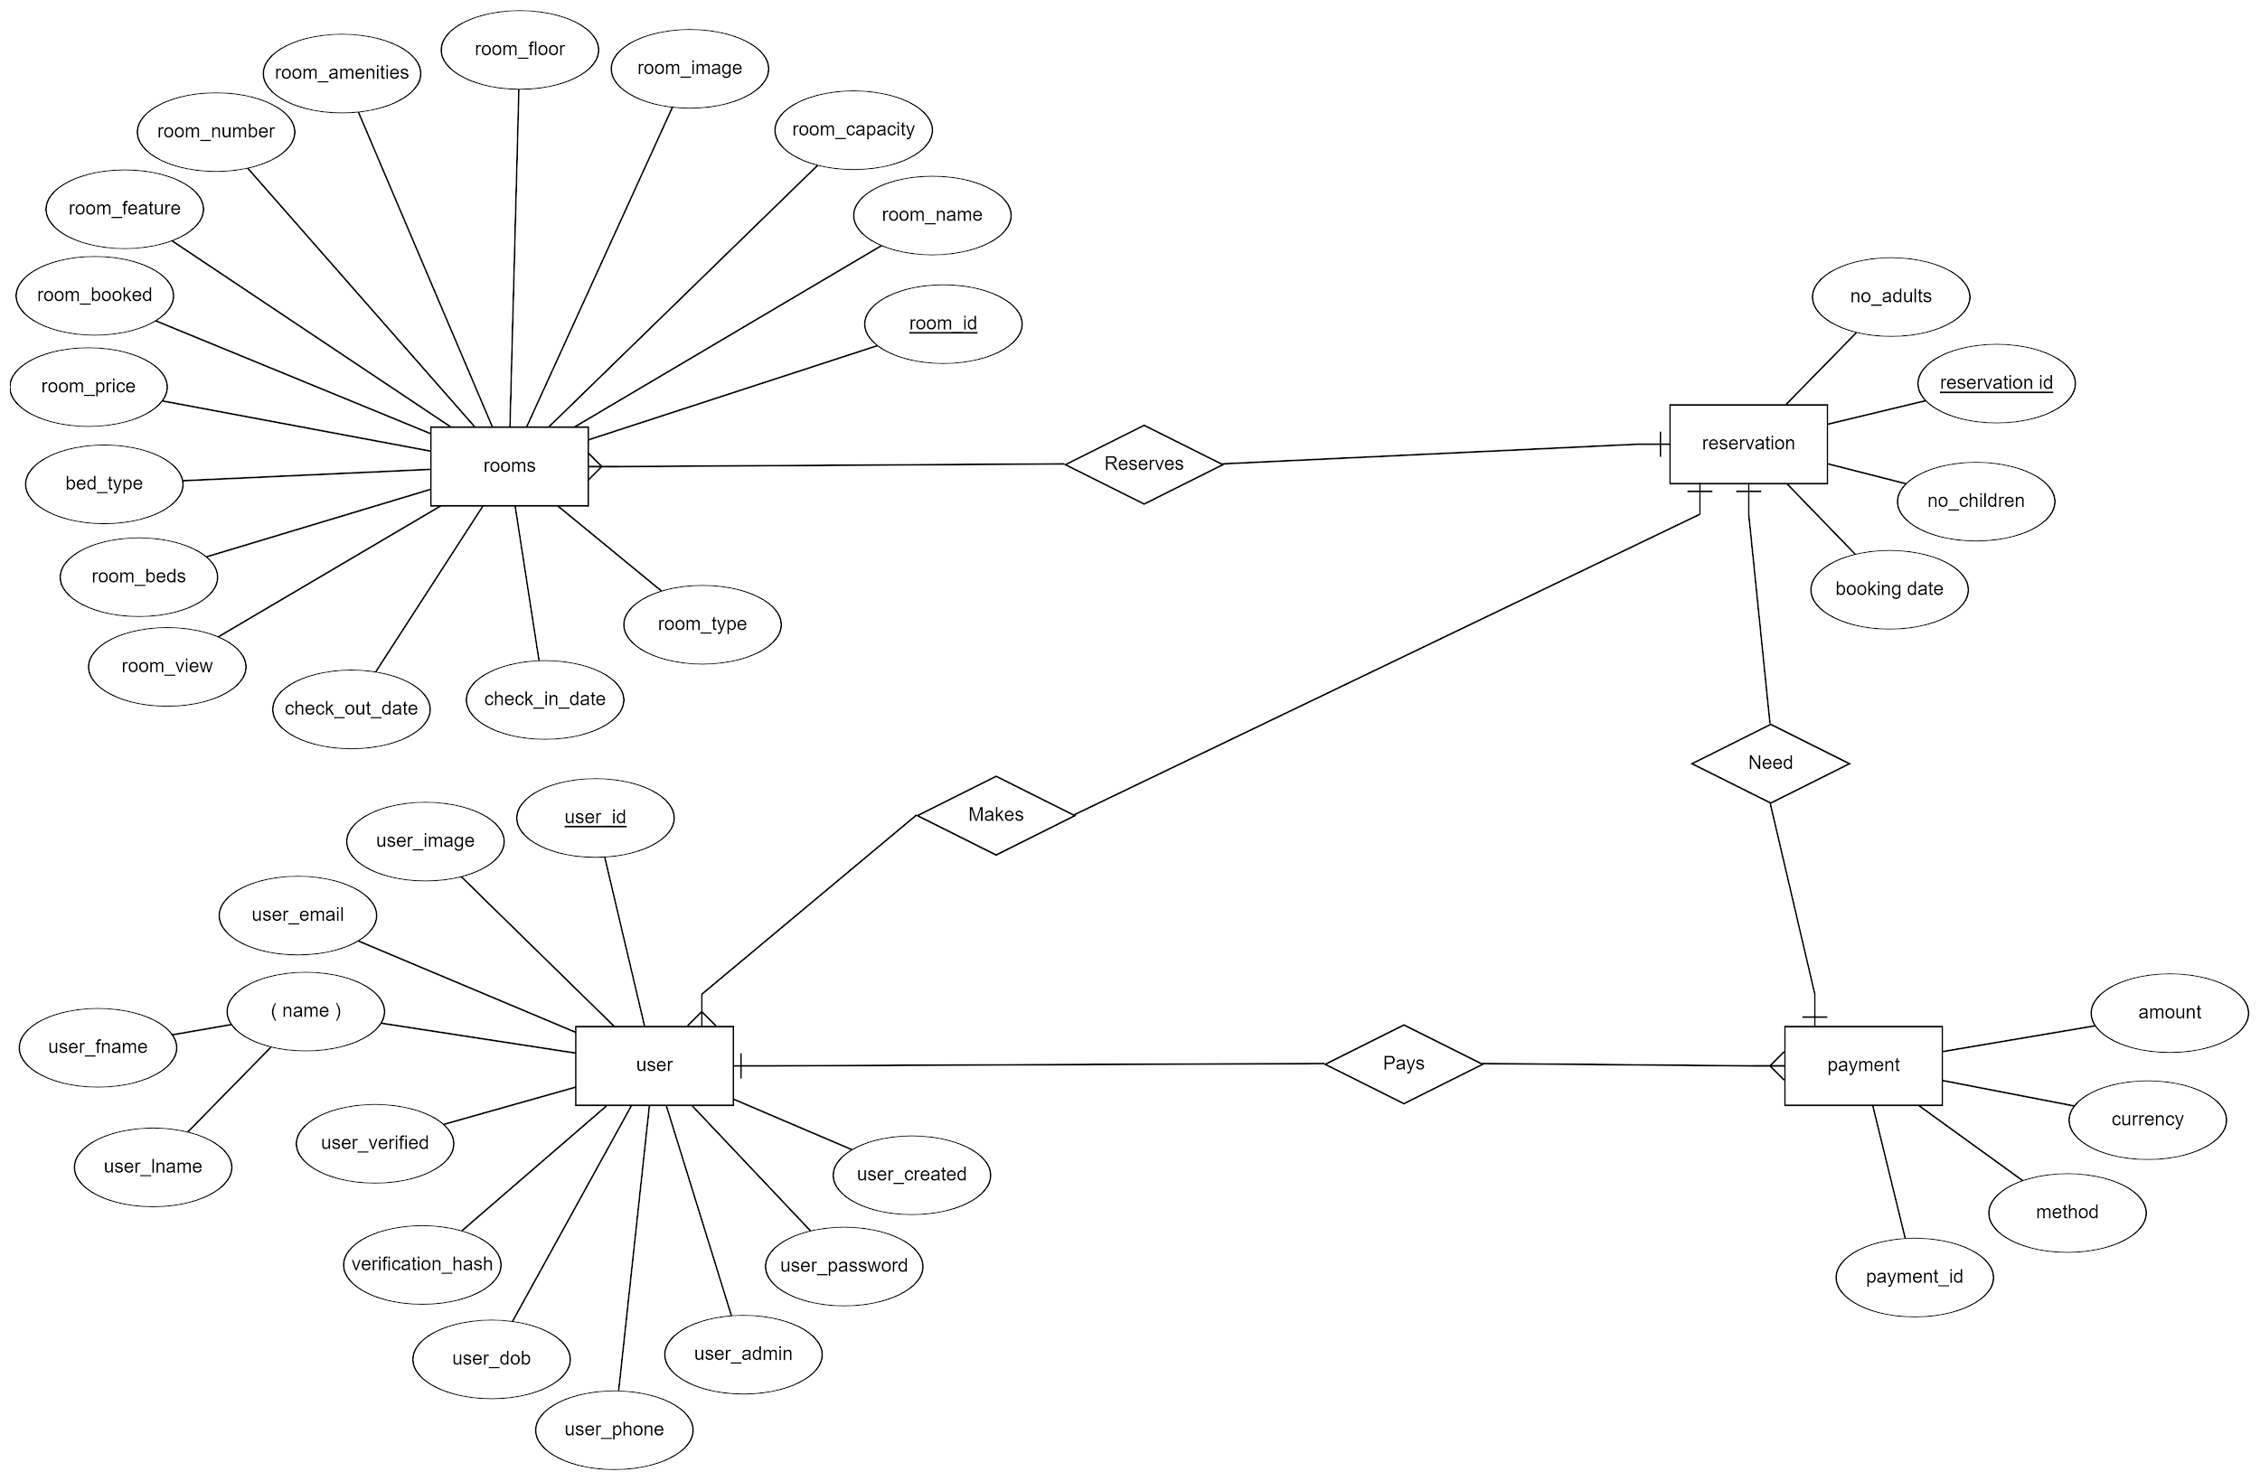
System description
5
Hotel Management System
Notes:
5

Slide 6
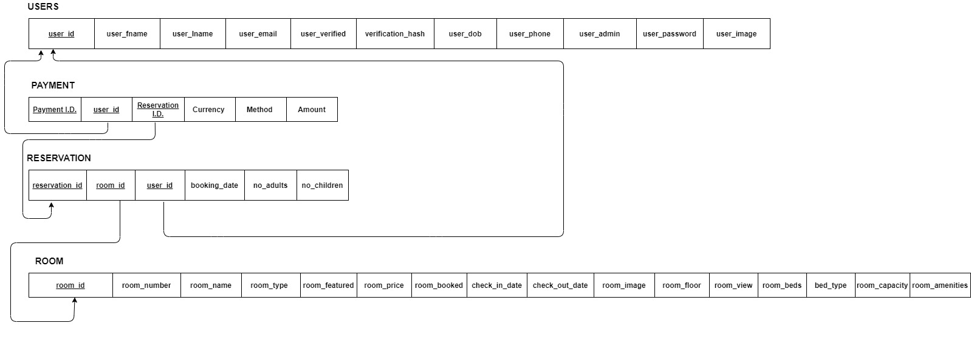
System description
6
Hotel Management System
Notes:
6

Slide 7
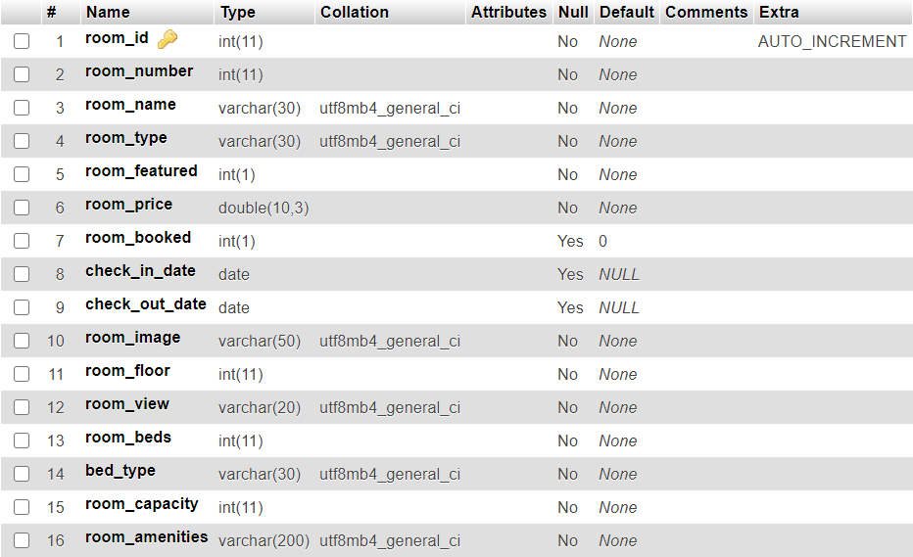
Database Tables
Room Table
7
Hotel Management System
Notes:
7

Slide 8
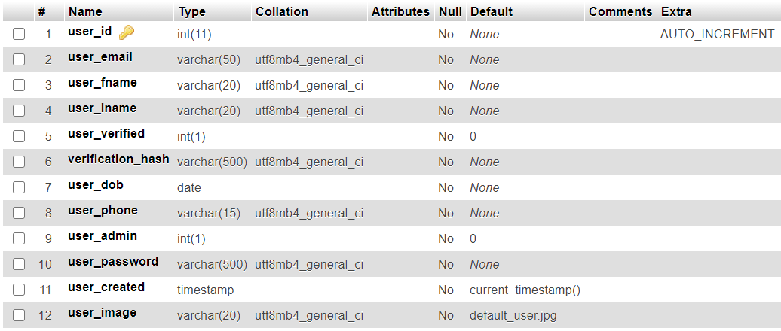
Database Tables
User Table
8
Hotel Management System
Notes:
8

Slide 9
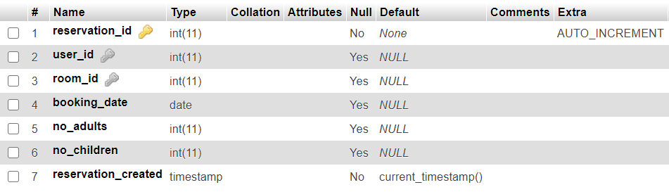
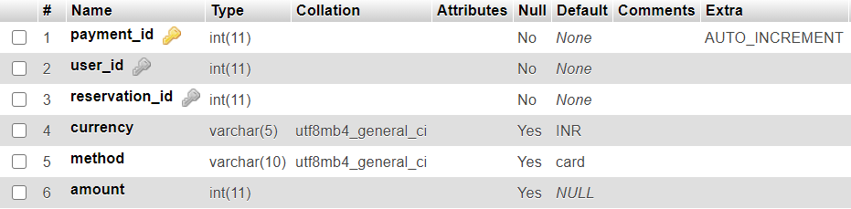
Database Tables
Reservation Table
Payments Table
9
Hotel Management System
Notes:
9

Slide 10



Hardware & software requirements
Software Requirements:
Development Tools:
Front End : HTML, CSS, JAVASCRIPT, JQUERY, BOOTSTRAP
Back End : PHP, MySQL
Operating System : Windows 10/11
Web server : XAMPP
Text Editor: VS Code
10
Hotel Management System
Notes:
10

Slide 11
Hardware & software requirements
Hardware Requirements
I/O devices
Monitor
Keyboard
Modern Computer with Modern Web Browser
Internet Connection
11
Hotel Management System
Notes:
11

Slide 12
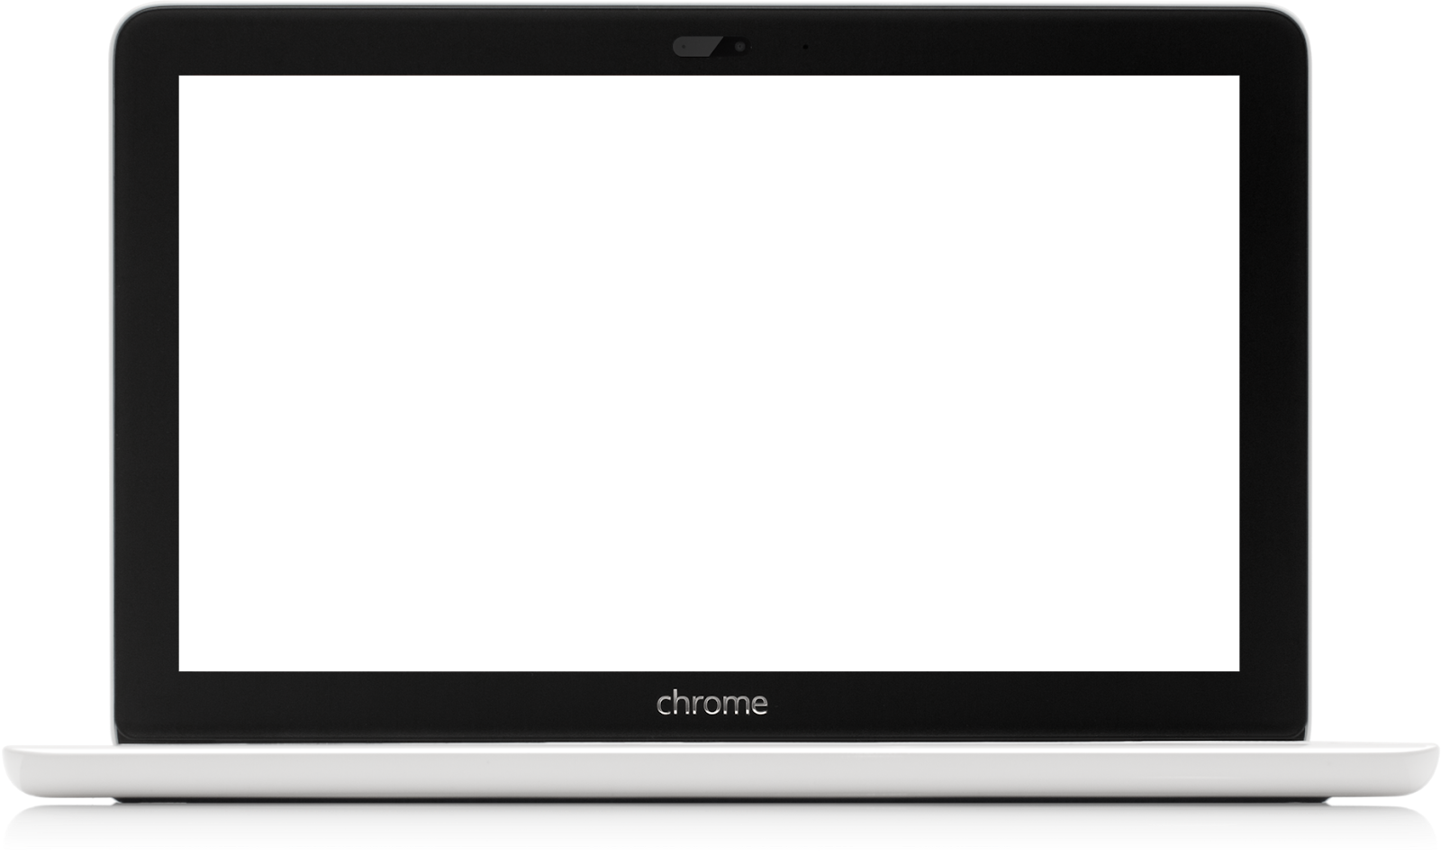
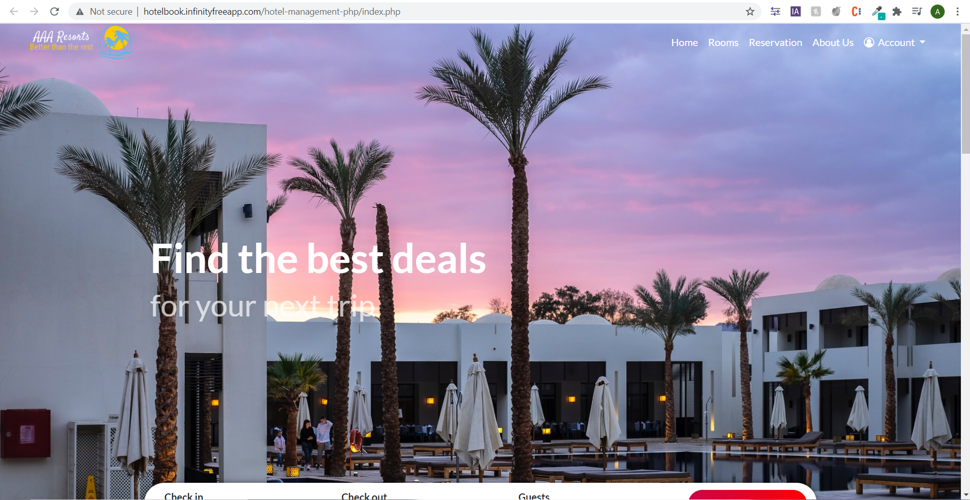

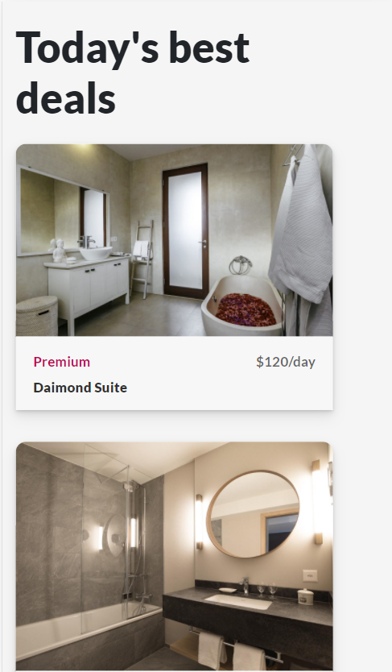
User Interface Design
Hotel Management System
12
Hotel Management System
Notes:
12

Slide 13
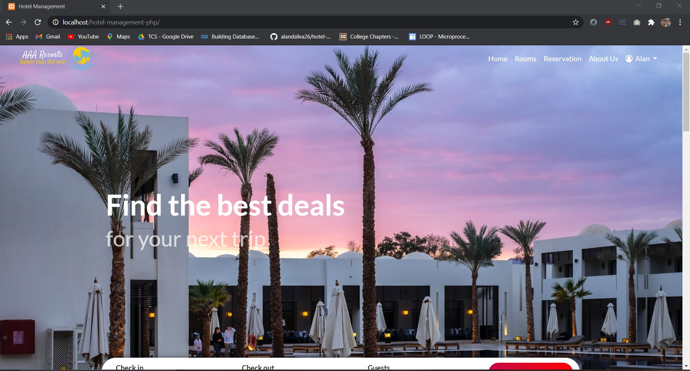
Homepage
13
Hotel Management System
Notes:
13

Slide 14
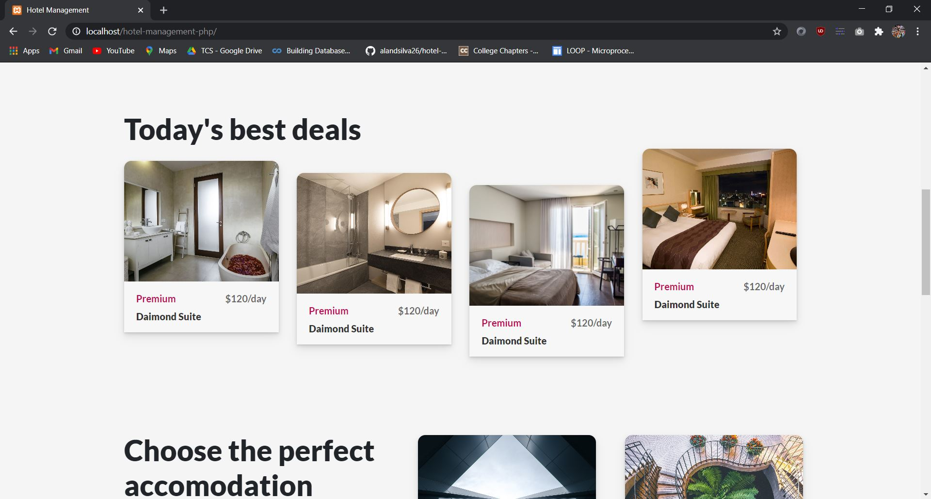
Homepage
14
Hotel Management System
Notes:
14

Slide 15
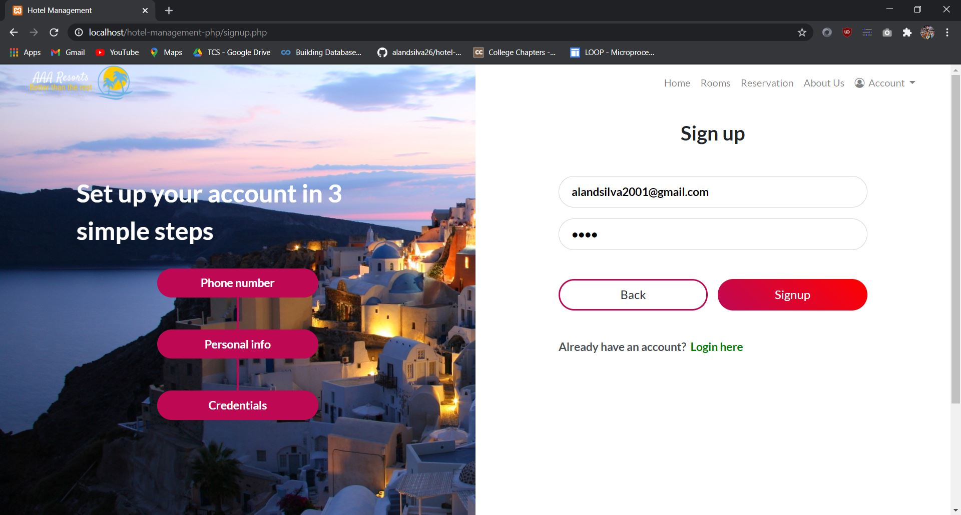
Sign Up
15
Hotel Management System
Notes:
15

Slide 16
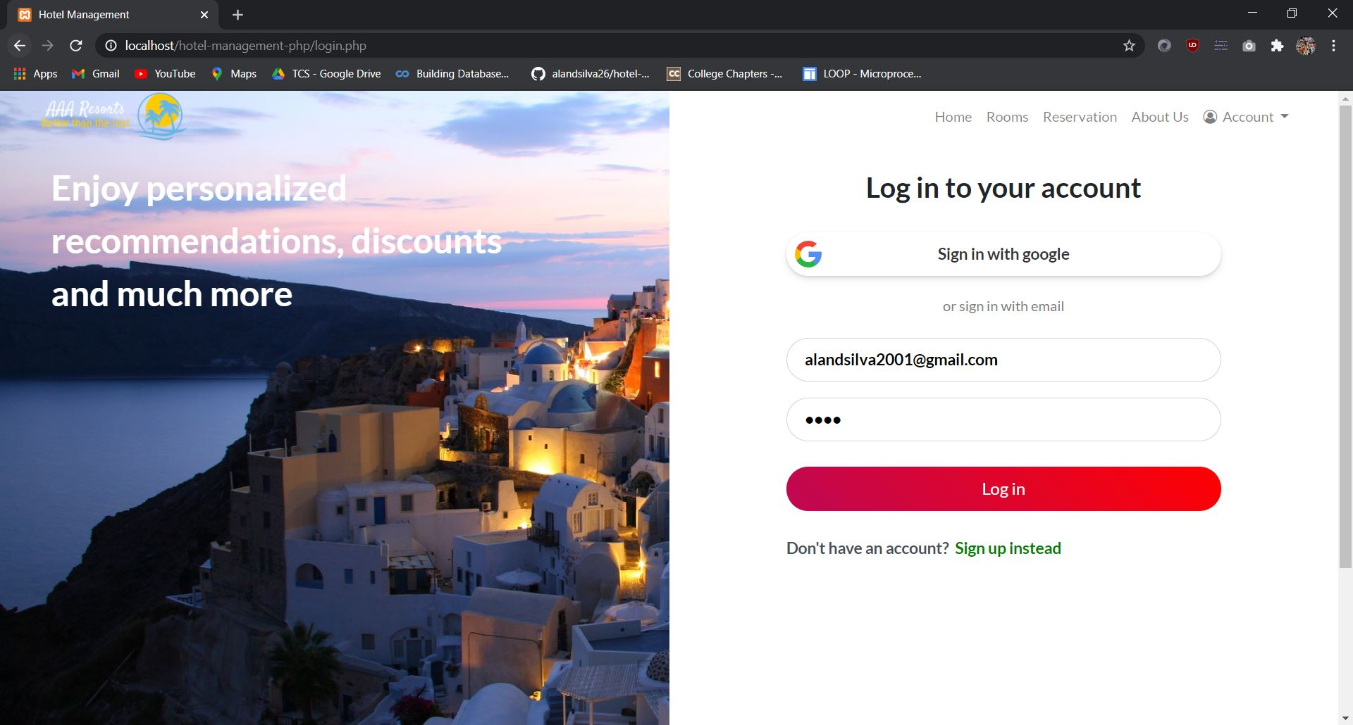
Login
16
Hotel Management System
Notes:
16

Slide 17
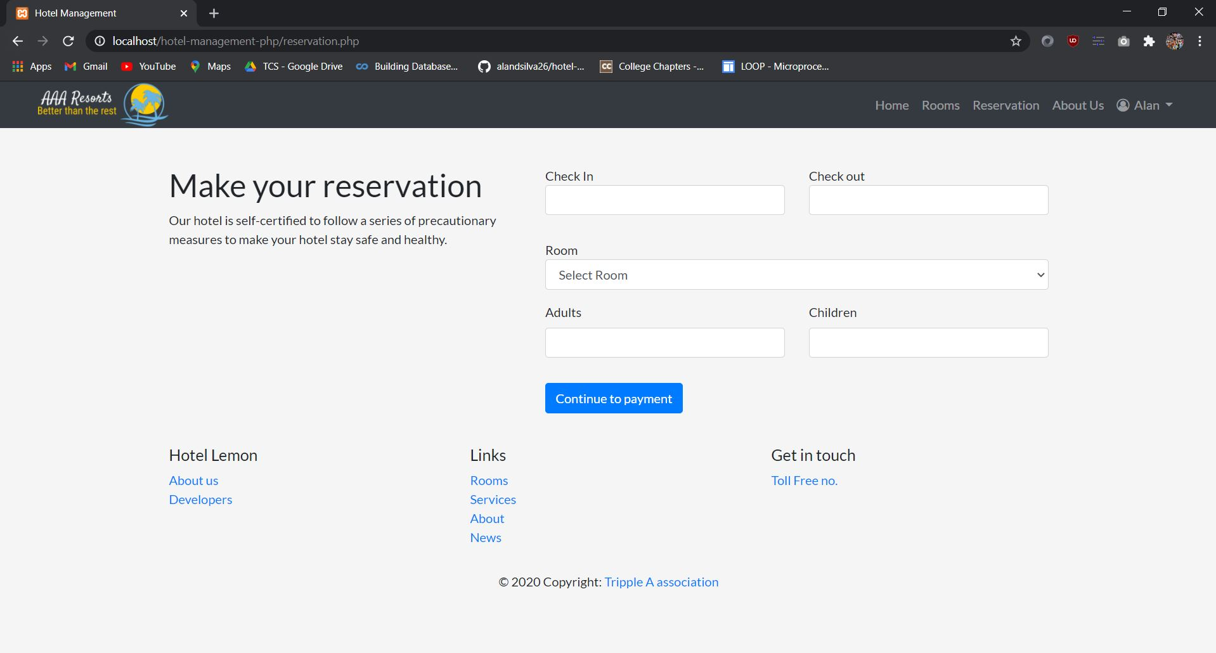
Reservation
17
Hotel Management System
Notes:
17

Slide 18
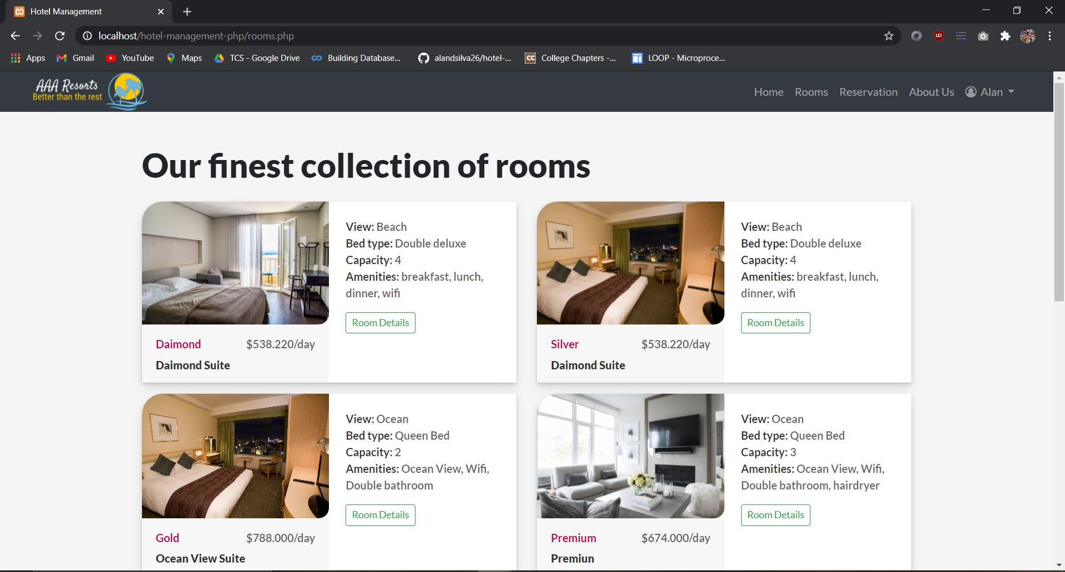
View Rooms
18
Hotel Management System
Notes:
18

Slide 19
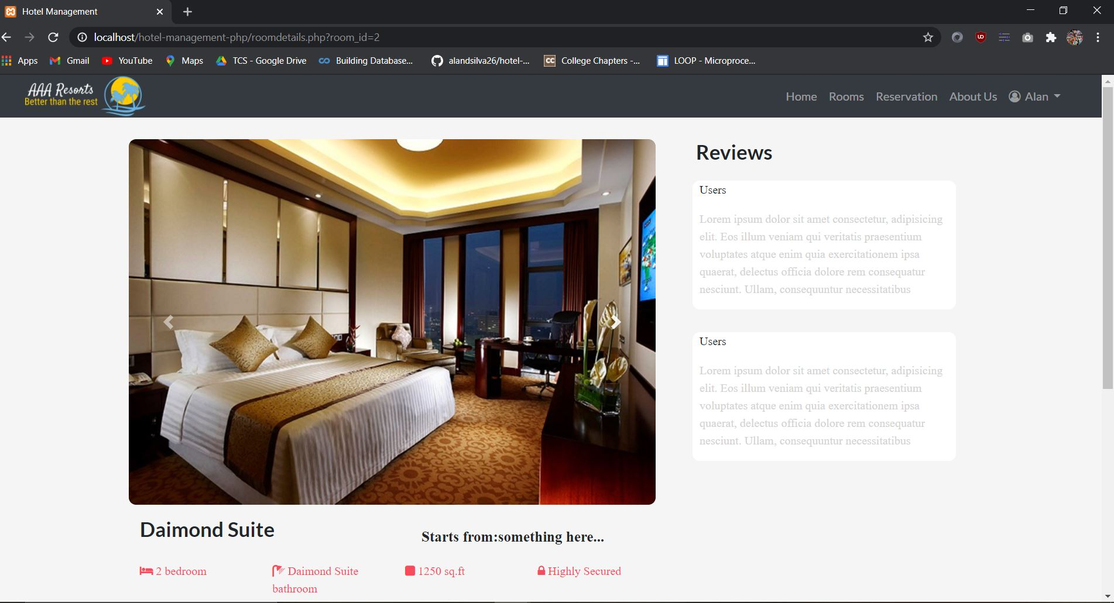
Room Details
19
Hotel Management System
Notes:
19

Slide 20
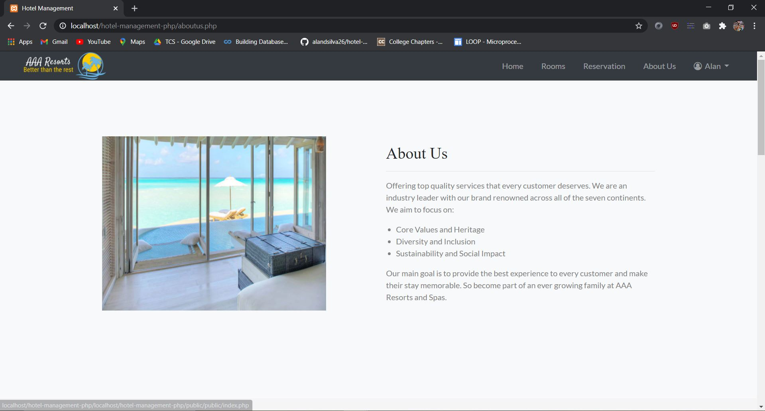
About Us
20
Hotel Management System
Notes:
20

Slide 21
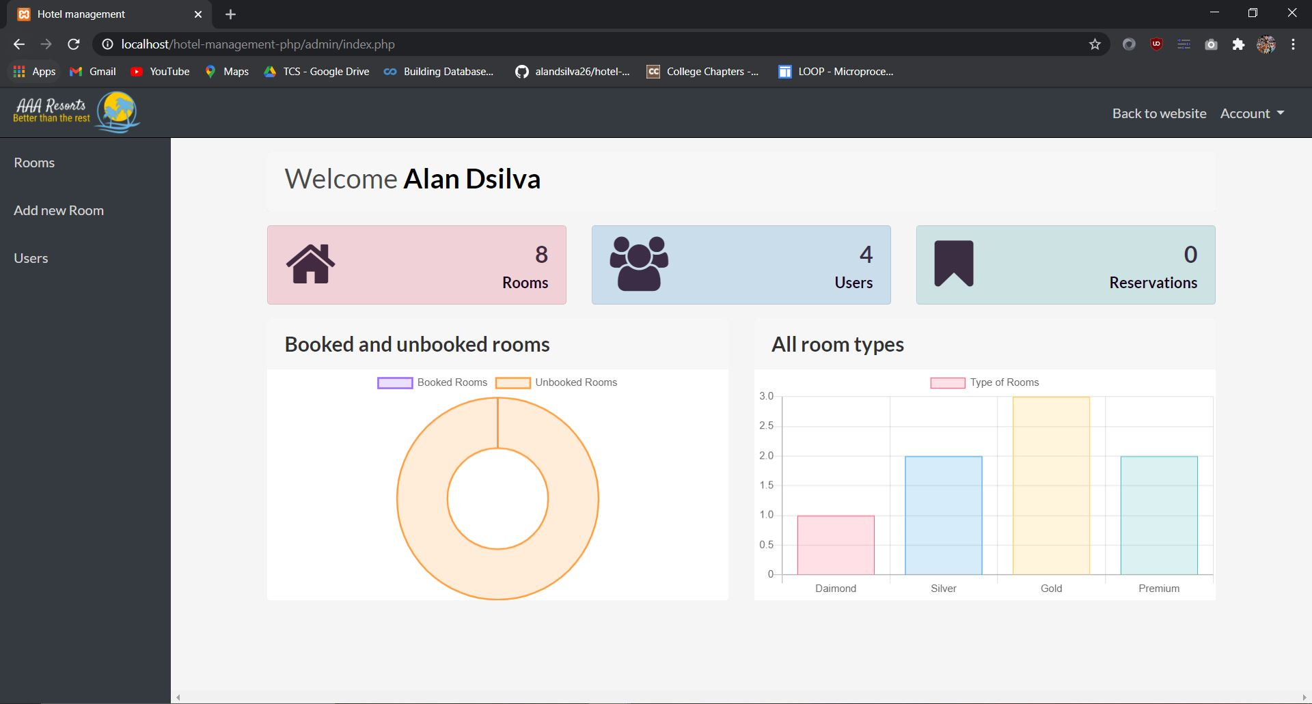
Admin Panel
21
Hotel Management System
Notes:
21

Slide 22
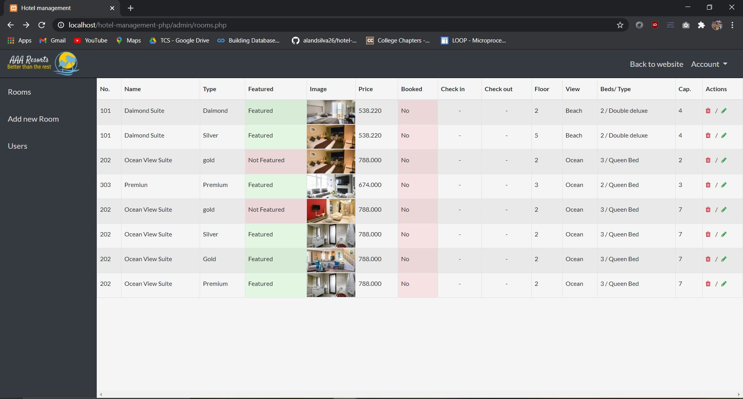
Admin Panel - Edit Rooms
22
Hotel Management System
Notes:
22

Slide 23
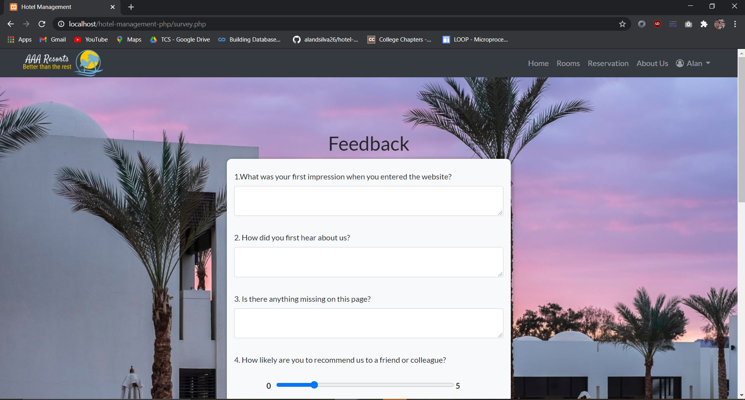
Feedback
23
Hotel Management System
Notes:
23

Slide 24
Applications of the System
This system will be performing the following tasks:
The system will provide an interface to login and register.
Check the features of the room along with a pictorial view.
Rooms can be booked based on their category and the capacity of people.
An admin user can also manage the details of rooms, view bookings, add rooms and delete rooms.
A created account includes the information such as date of birth, name, phone-number, email and a password. All this data is stored in the database.
Password storage is also done using an encrypted hash. Email verification is also done using a verification hash.
24
Hotel Management System

Slide 25
Conclusion
The Hotel Management system is a web based application. The main aim in this project was to make it seamless to book rooms at a hotel. It also is aimed to make the managing of the rooms and users easy and hassle free for the admin.
An appealing and intuitive user interface along with graphical representation of room information makes the user experience enjoyable for both customer and admin.
25
Hotel Management System
Notes:
25

Slide 26
Future Scope
The system can be used by both large scale and small scale hotels.
There is future scope of booking room service or other amenities to the room
Expanding the project to include a chain of hotels.
Adding an employee management system.
26
Hotel Management System
Notes:
26

Slide 27
Literature Cited(book and web References)
https://www.w3schools.com/
https://getbootstrap.com/
https://github.com/PHPMailer/PHPMailer
www.coursera.com
https://github.com/mpdf/mpdf
www.youtube.com
27
Hotel Management System
Notes:
27

